Slide 1
Docker and Kubernetes
Course category/code

Slide 3
Trainer’s Introduction

Slide 4

About NTUC LearningHub

Slide 5
9 hours x 4 days
5 hours x 1 days
45 hours
4 hours

Slide 6
Assessment format: open/closed book
Open book assessment ONLY includes LG and approved materials
Appeal process

Slide 7
First day briefing for trainees - assessment
Place phones & other materials under the table or on the floor
No photos or recording of assessment scripts
No discussion during assessment
Use black/blue pen for assessment [hard copies]
No usage of liquid paper or correction tape

Slide 8
First day briefing for trainees - assessment
Refer to clock countdown timer during assessment (search Clock App under Windows)
Assessment scripts will be collected when the time is up

Slide 9
First day briefing for trainees
Criteria for funding
Minimum attendance rate of xxx%
Complete the assessment and be assessed as ‘Competent’

Slide 10
SECTION BREAK

Slide 11
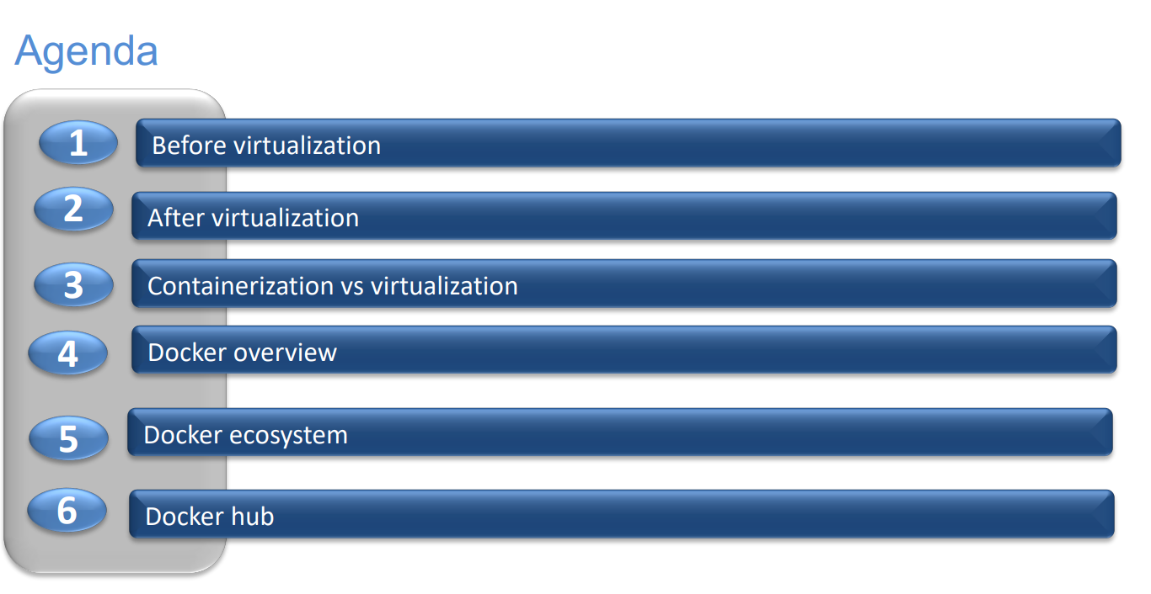

Slide 12


Slide 13
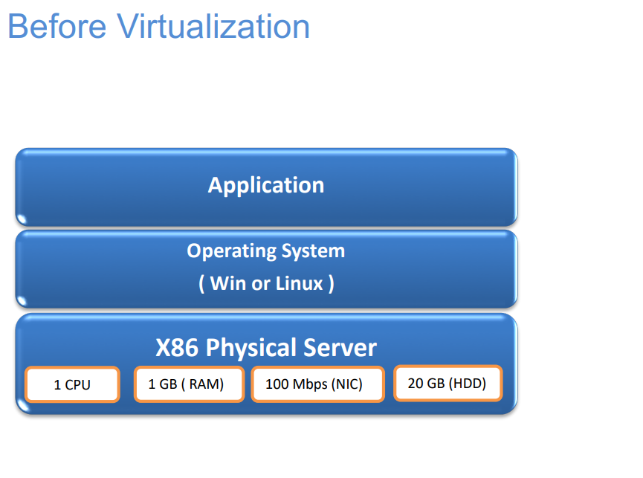

Slide 14
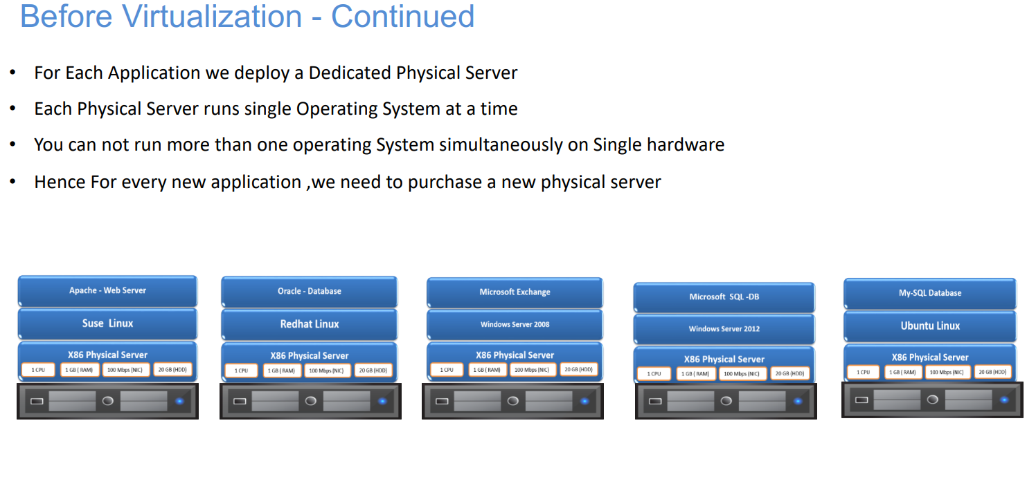

Slide 15


Slide 16
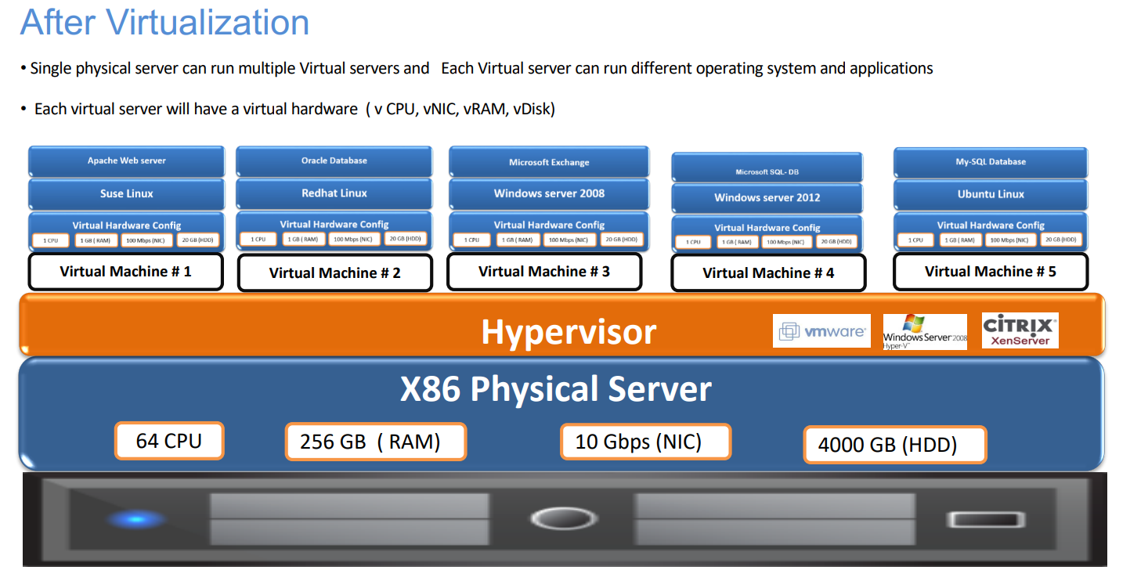

Slide 17


Slide 18
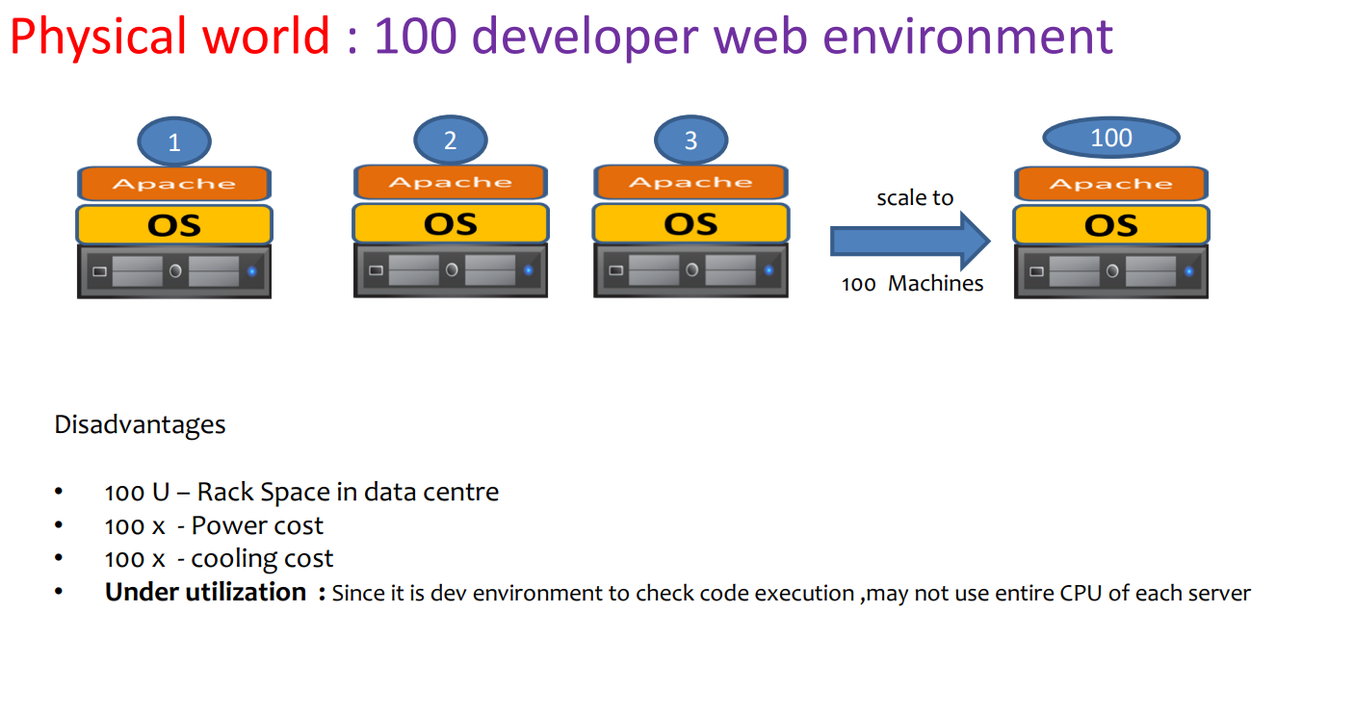

Slide 19
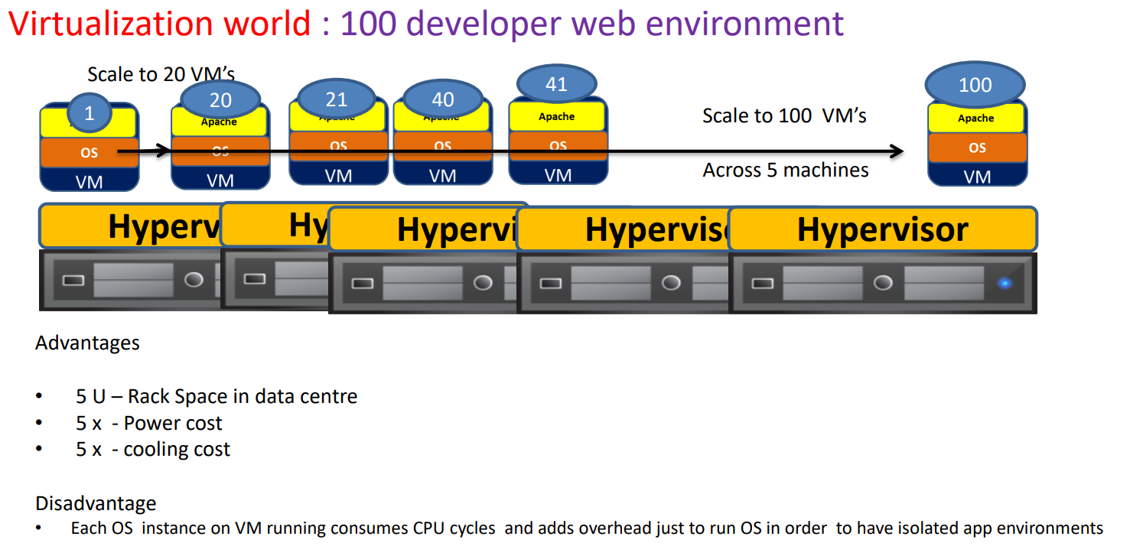

Slide 20
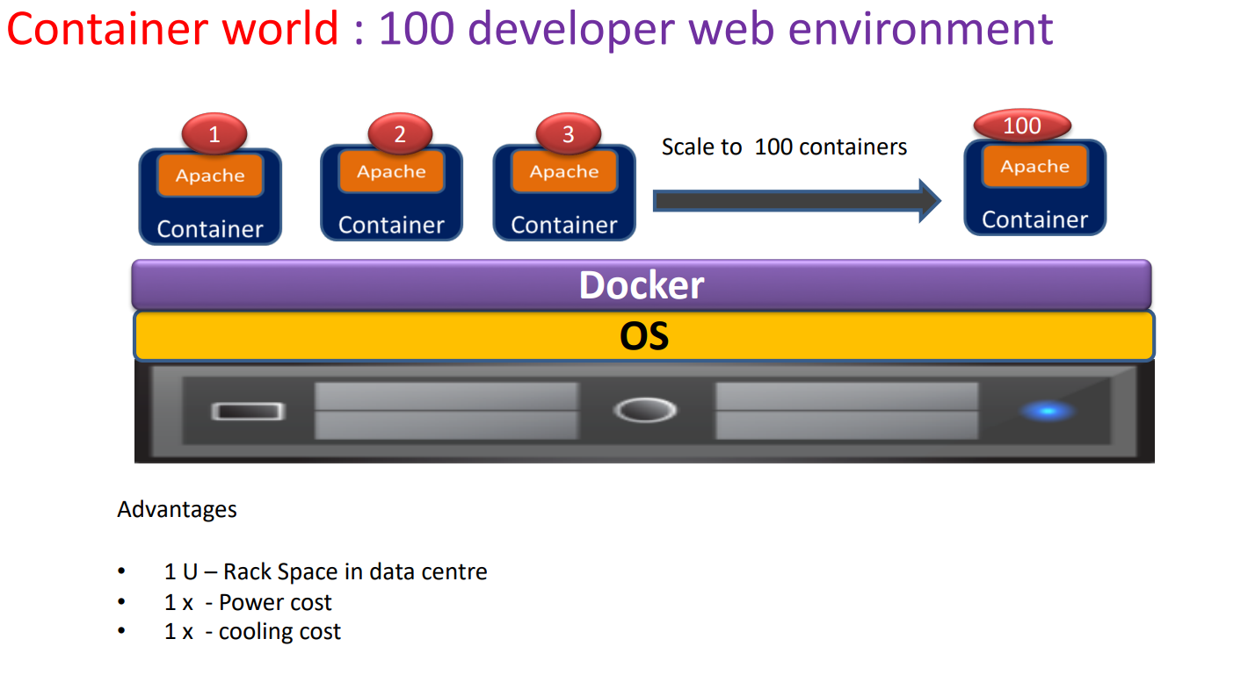

Slide 21
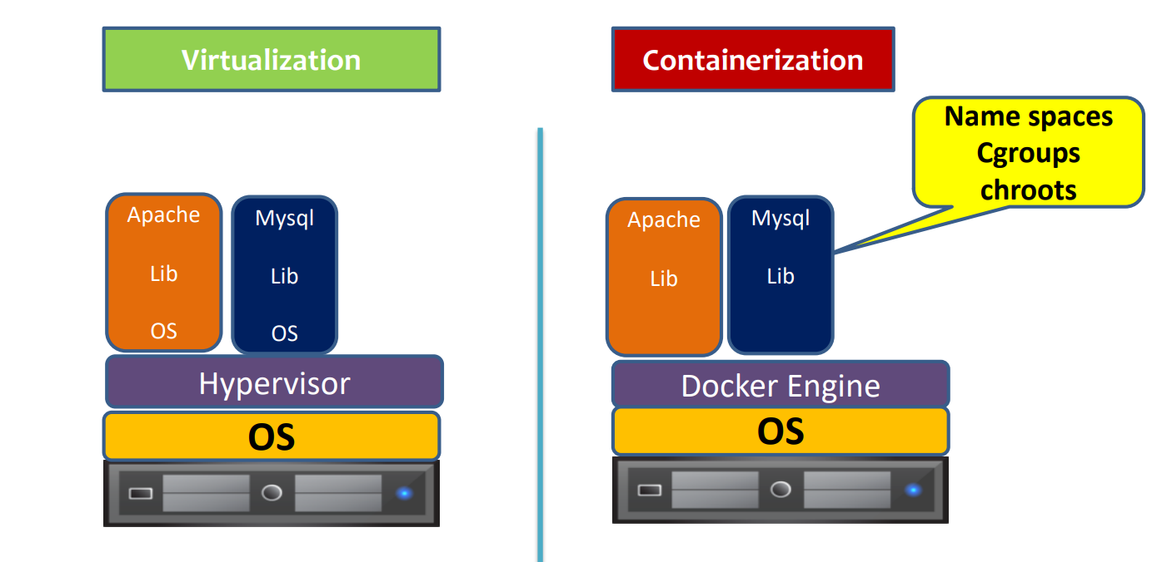

Slide 22
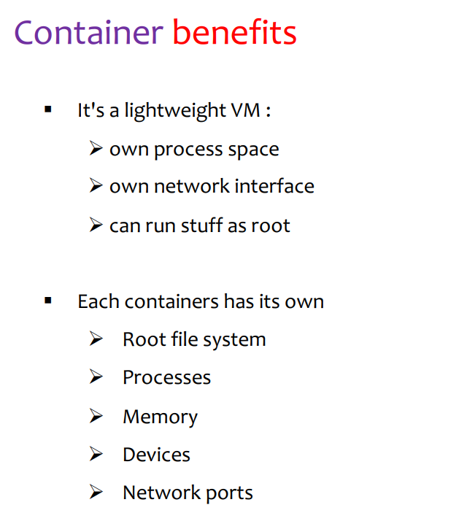

Slide 23
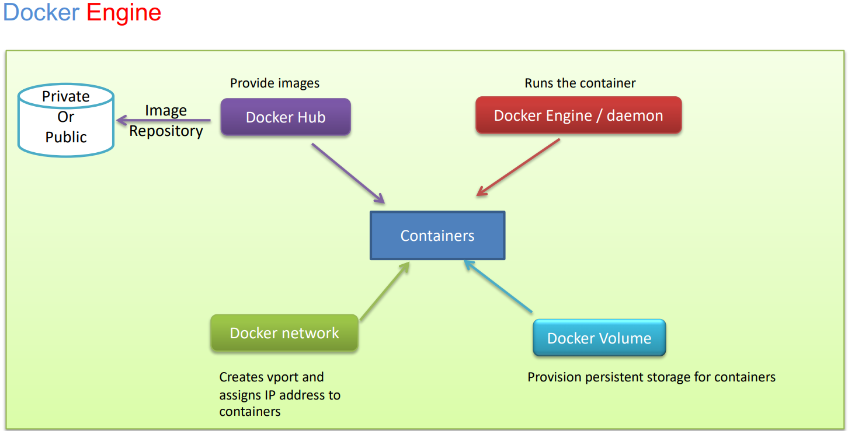

Slide 24
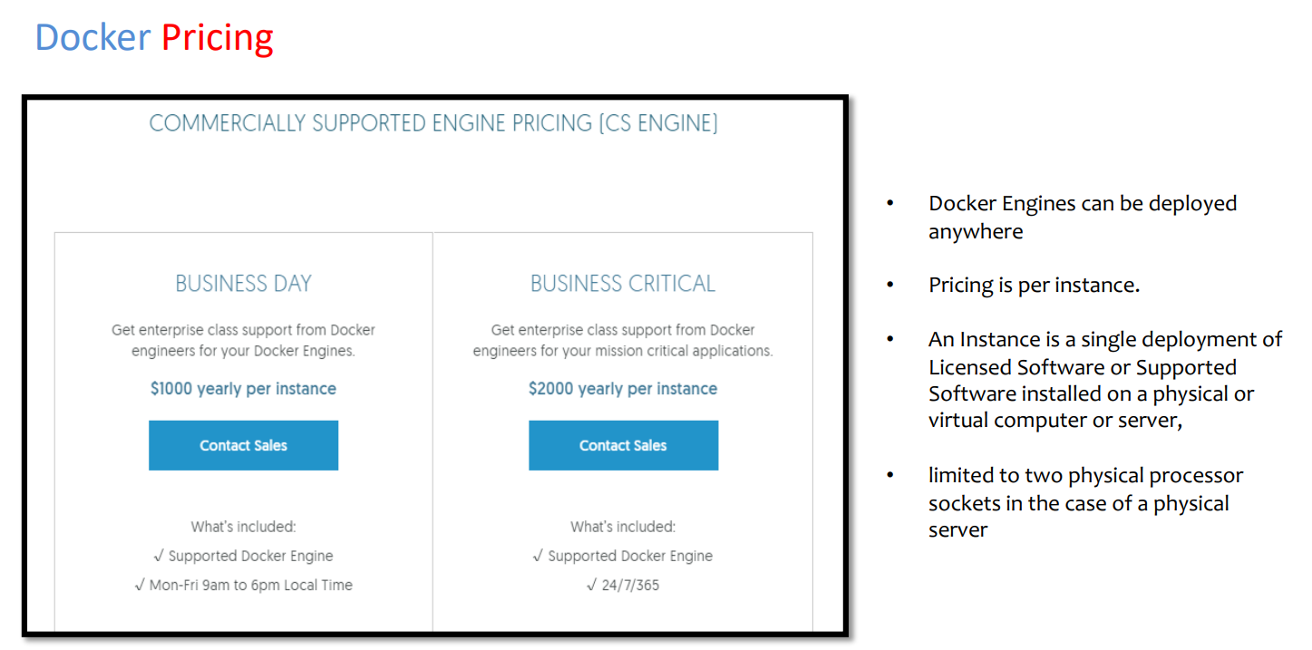

Slide 25


Slide 26
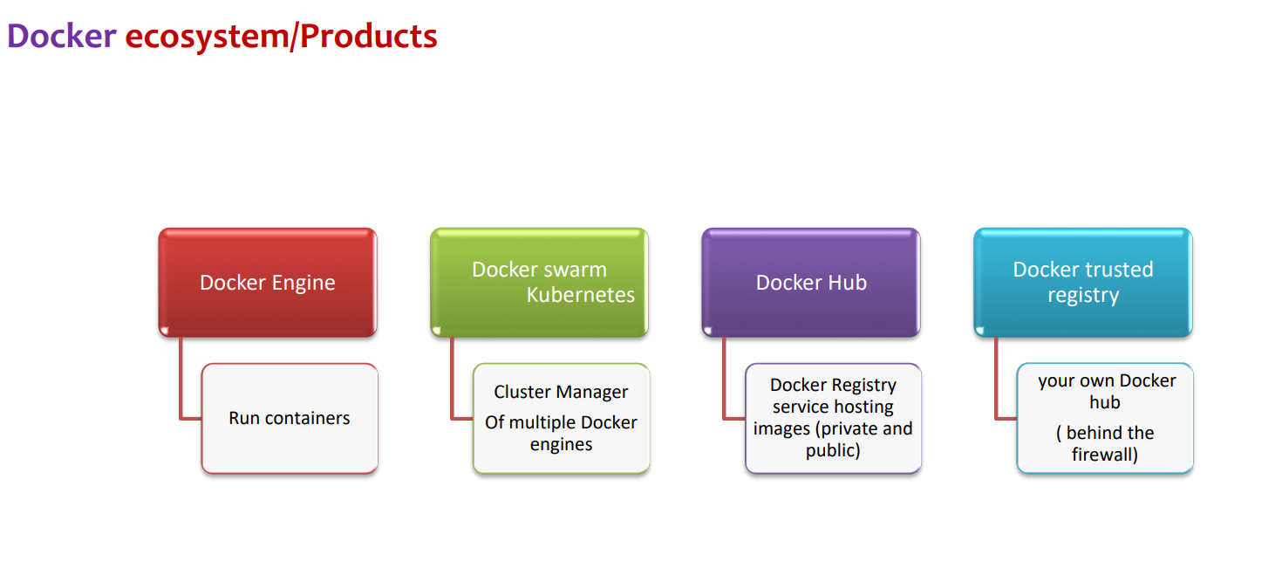

Slide 27
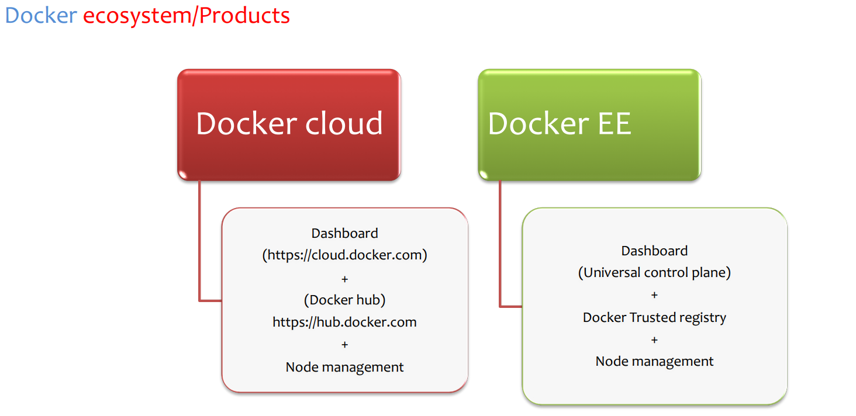

Slide 28


Slide 29
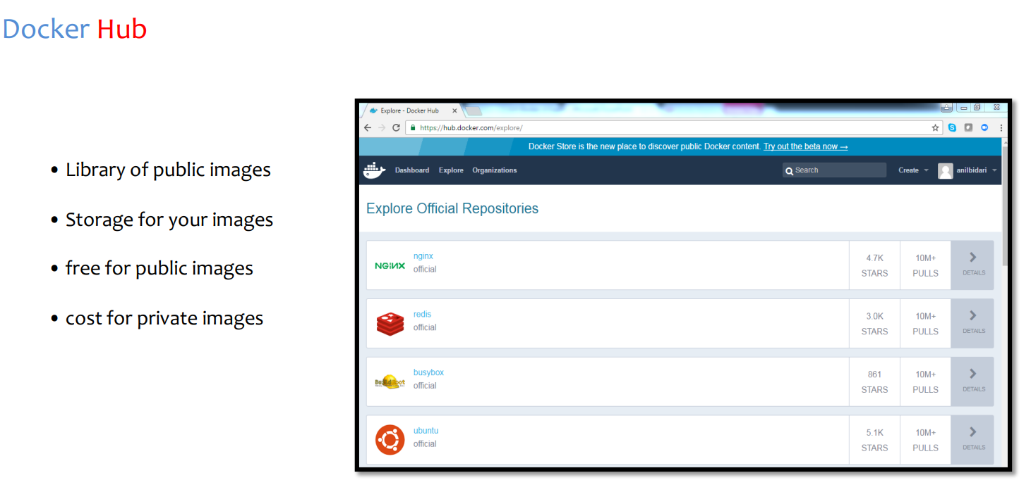

Slide 30


Slide 31
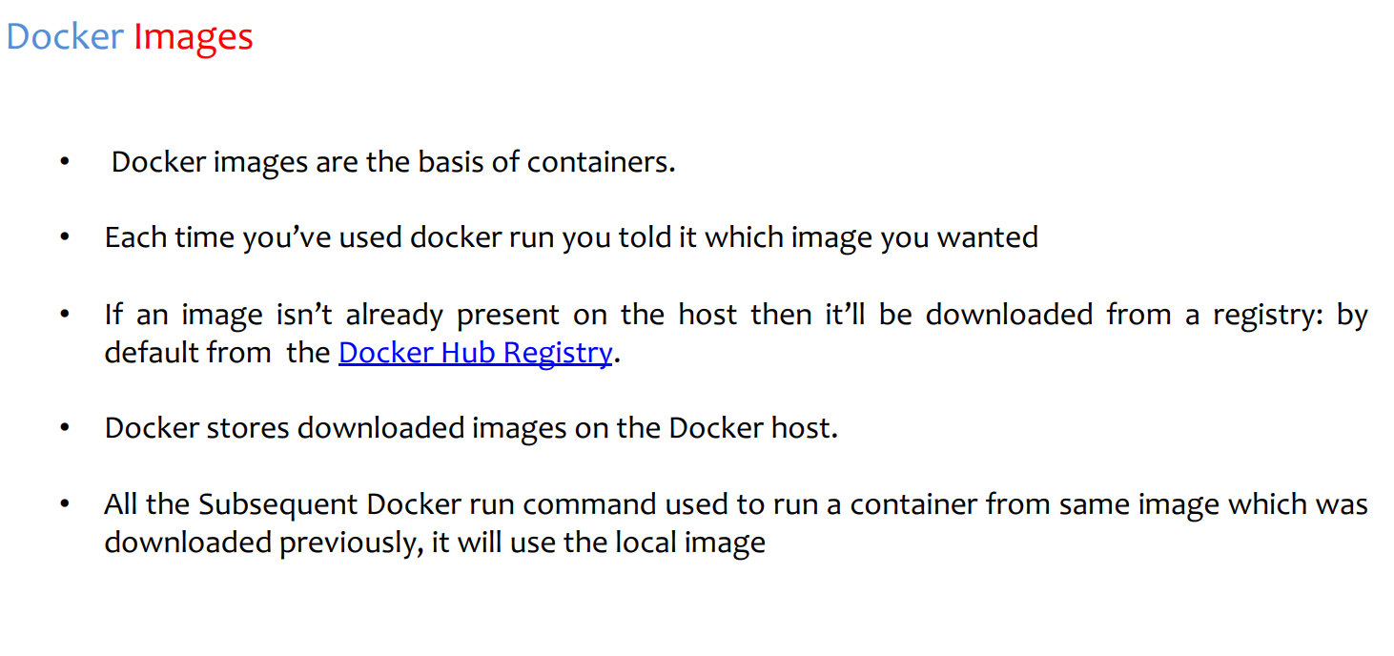

Slide 32
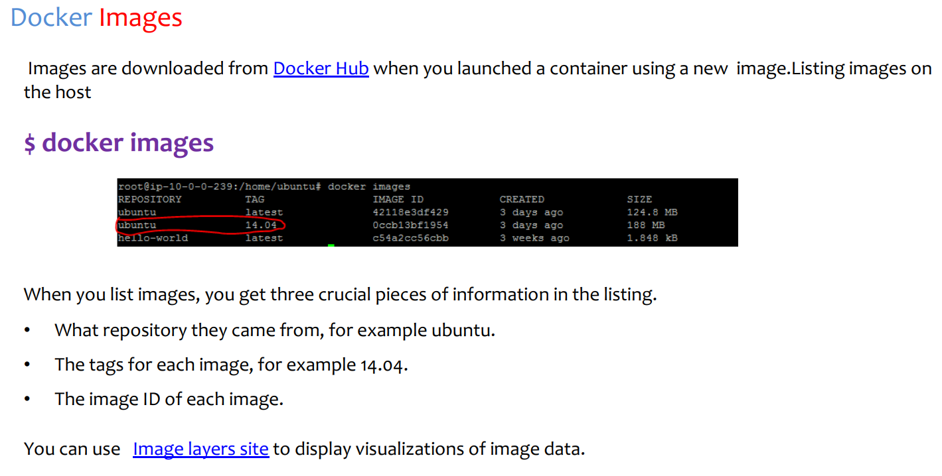

Slide 33


Slide 34
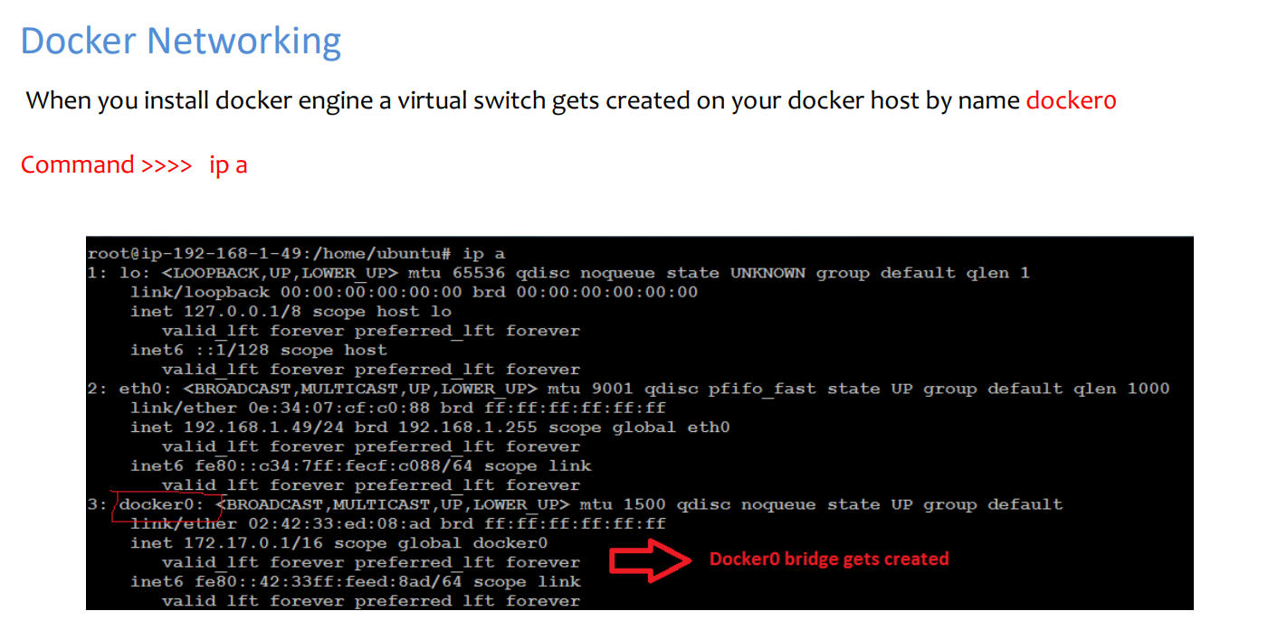

Slide 35
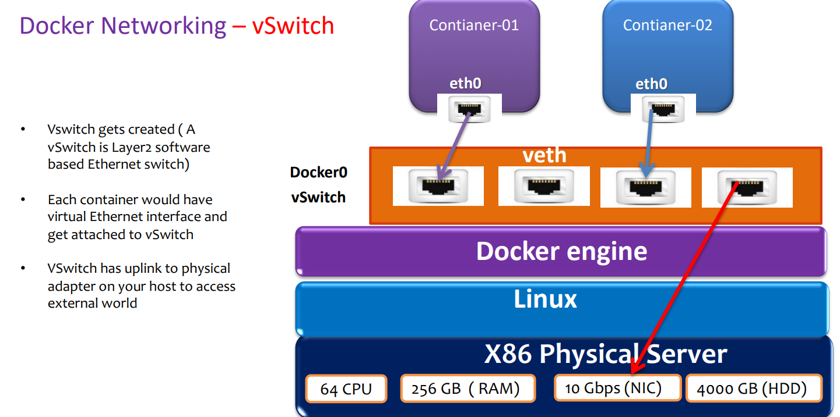

Slide 36
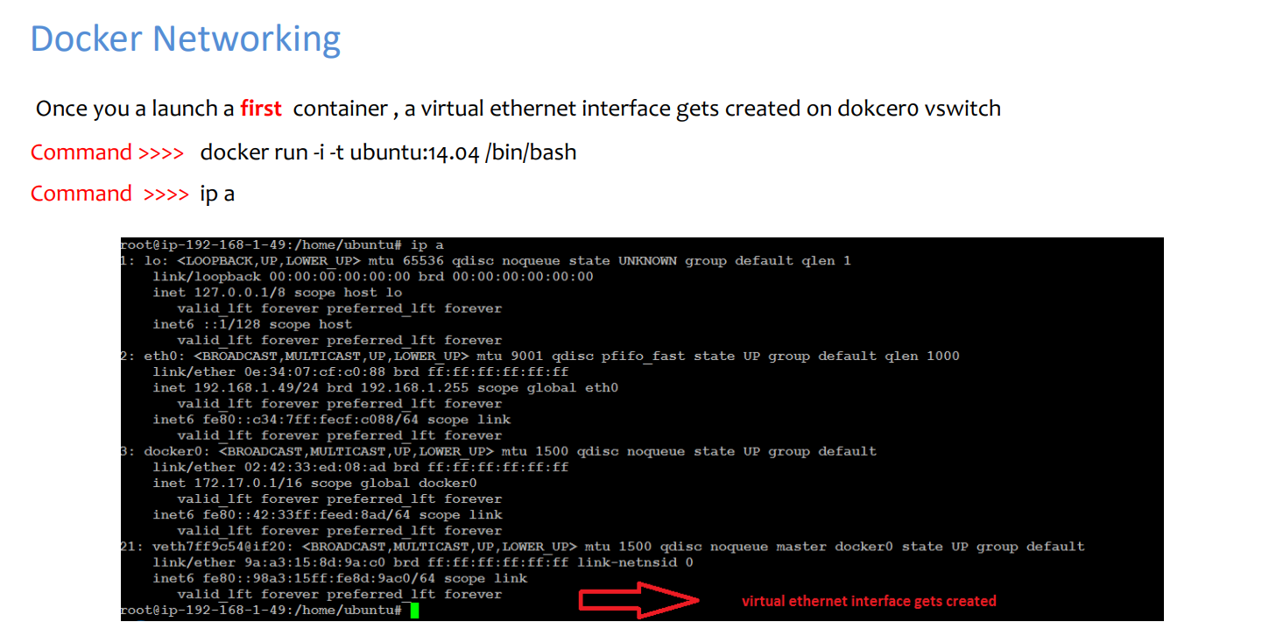

Slide 37
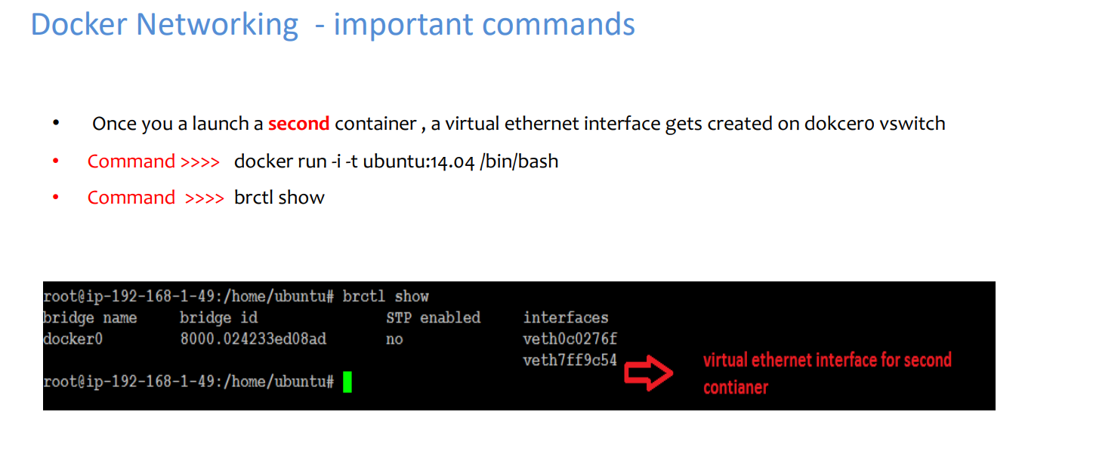

Slide 38
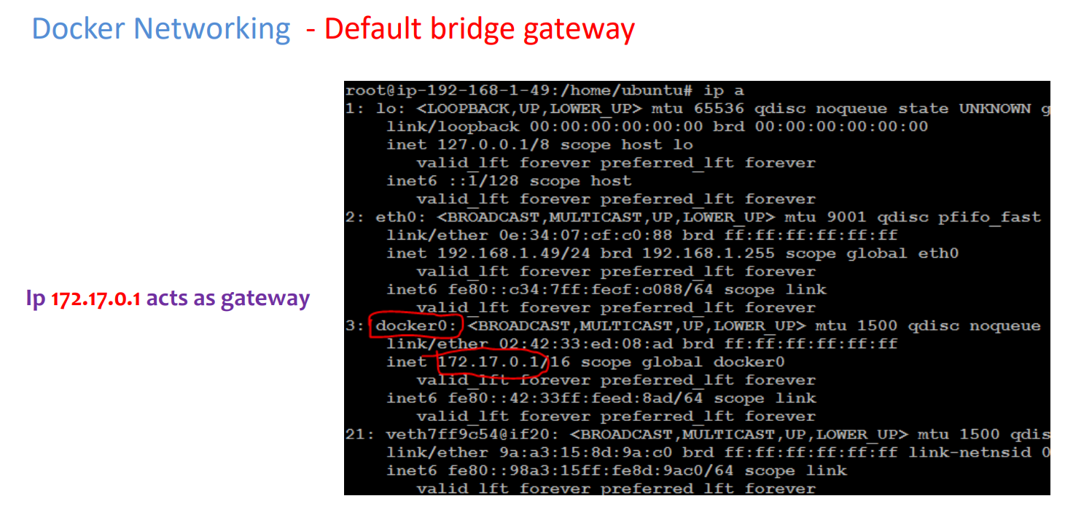

Slide 39
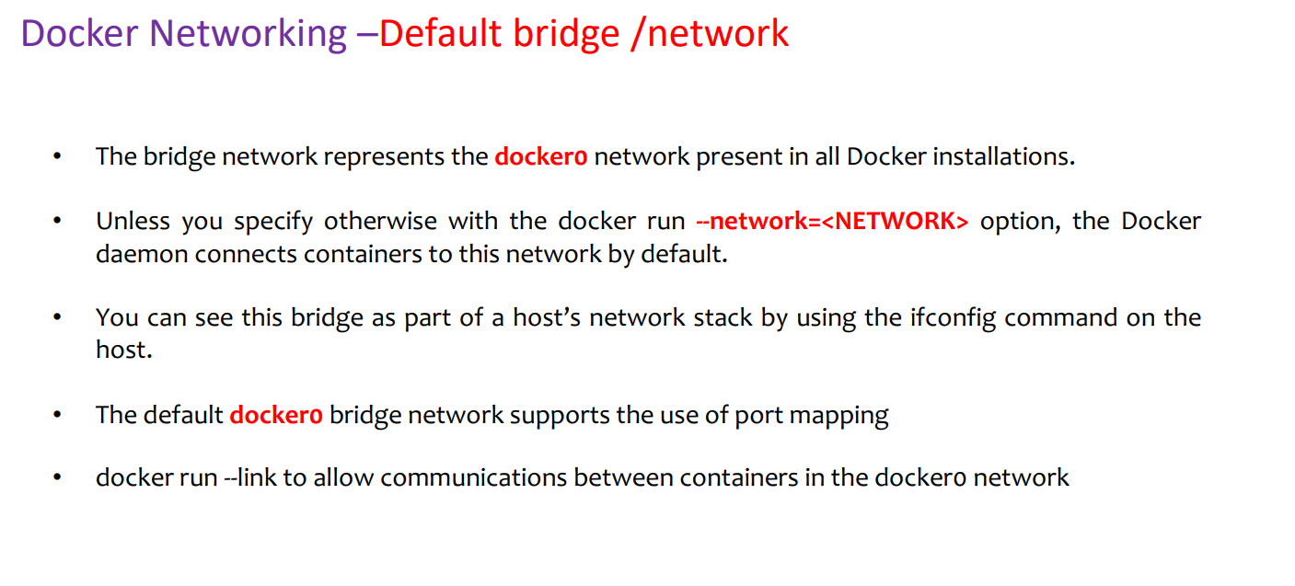

Slide 40
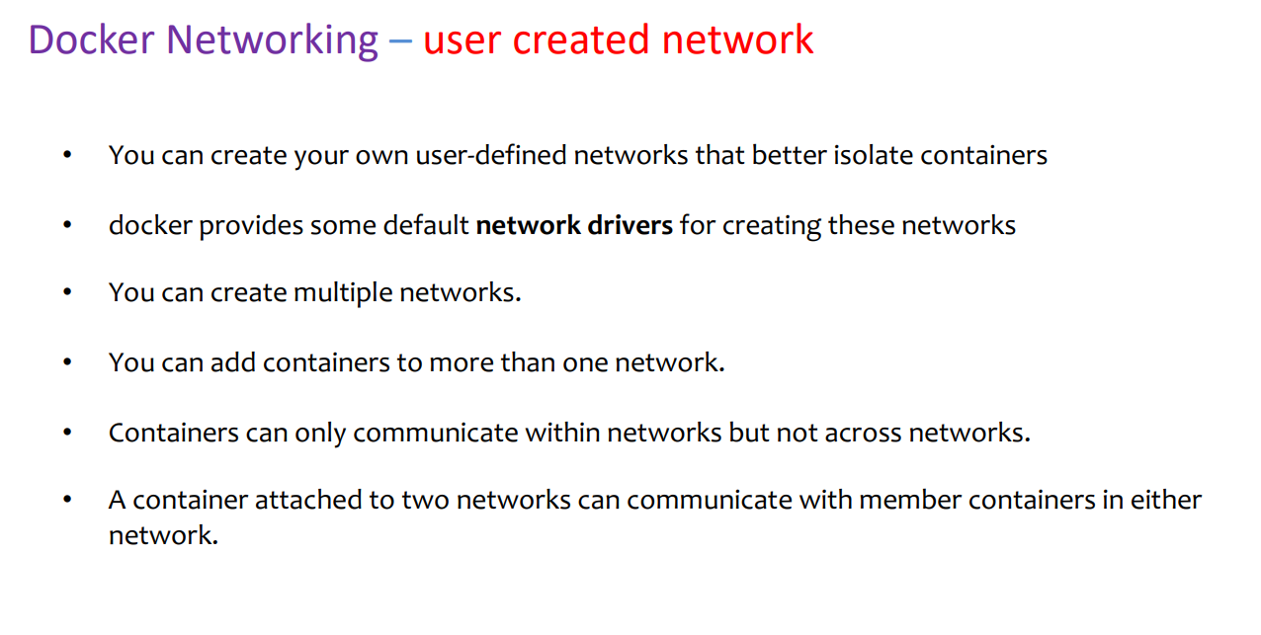

Slide 41
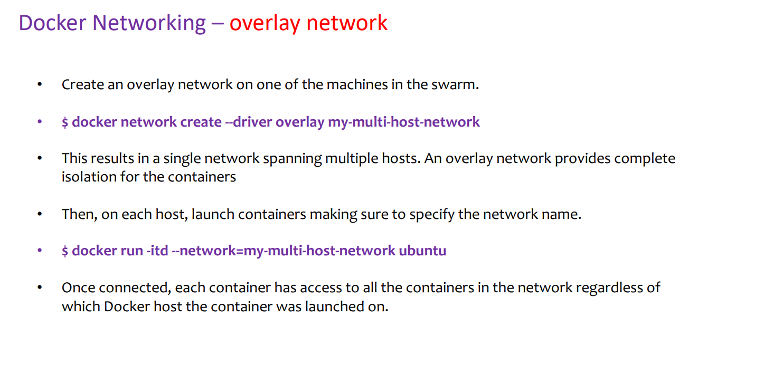

Slide 42
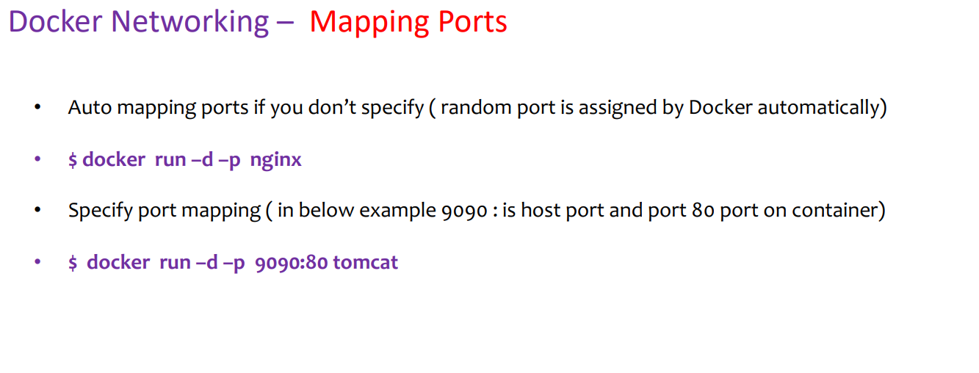

Slide 43
Thank You

Slide 44


For more course enquiries, visit us at:
Branches / Sales Centres
NTUC LHUB @ NTUC Trade Union House, 73 Bras Basah Road, #02-01, S189556
NTUC LHUB @ Devan Nair Institute, 80 Jurong East Street 21, #02-03, S609607
NTUC LHUB @ Lifelong Learning Institute, 11 Eunos Road 8, #05-01, S40860
NTUC LHUB @ Tampines Mall, 4 Tampines Central 5 (L4, outside Long John Silver’s), S529510
NTUC LHUB @ AMK Hub, 53 Ang Mo Kio Ave 3, #B1-80, S569933
NTUC LHUB @ NorthPoint City, North Wing, #B1-39, 930 Yishun Ave 2, S769098
NTUC LHUB @ Causeway Point, 1 Woodlands Square, #03-K03, S738099
NTUC LHUB @ Compass One, 1 Sengkang Square, #04-23, S545078
NTUC LHUB @ Jurong Point 2, 1 Jurong West Central 2, #03-119, S648886
Training Centres
NTUC LHUB Industry Skills Centre @ Benoi, 60 Benoi Road, #01-08, S629906
NTUC LHUB @ Aljunied Training Centre, 260 Sims Ave, ECM Building, #02-01, S387604
NTUC LHUB @ Tampines Plaza 2, Tampines Plaza, 5 Tampines Central 1, #04-02, S529541
6336 5482
www.ntuclearninghub.com
Notes:
Website
www.ntuclearninghub.com

